Slide 1
NON ACCIDENTAL INJURY (NAI)
M Anto
ED Prov Fellow MVH
10 Nov 2016

Slide 2
Why is NAI important?
Immediate: physical injuries.
Longterm: MH issues.
Missed unless thought about.
Classification (NSW):
Neglect
Physical
Sexual
Emotional
Exposure to DV

Slide 3
Risk factors?

Slide 4
Risk factors
Low SES
Unemployed
Single parent
Substance abuse
1st child
Prem
Unplanned
Stepchildren
Disability
Hx of parental abuse
Birth parents more likely to abuse!

Slide 5
Questions!!!
What are concerning features on history or examination (excluding injuries) would make you suspicious of NAI?
What injuries are suspicious for NAI?

Slide 6
History
Details
Delay
PHx of same

Slide 7
Examination
Caregiver
Child
Interaction
Neglect

Slide 8
Injuries

Slide 9
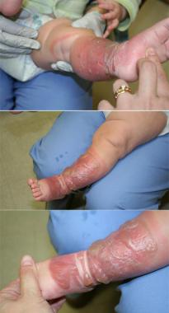

Slide 10
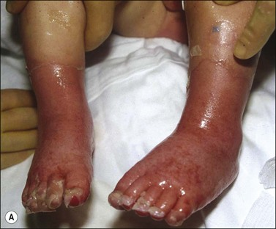

Slide 11
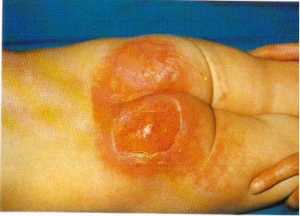

Slide 12
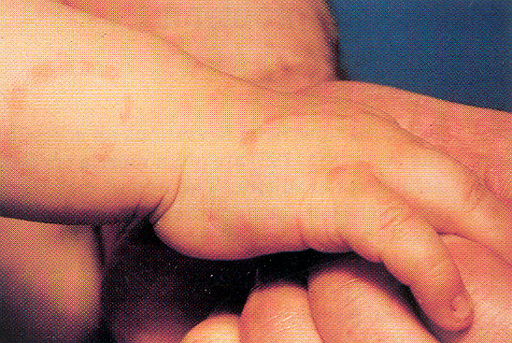

Slide 13
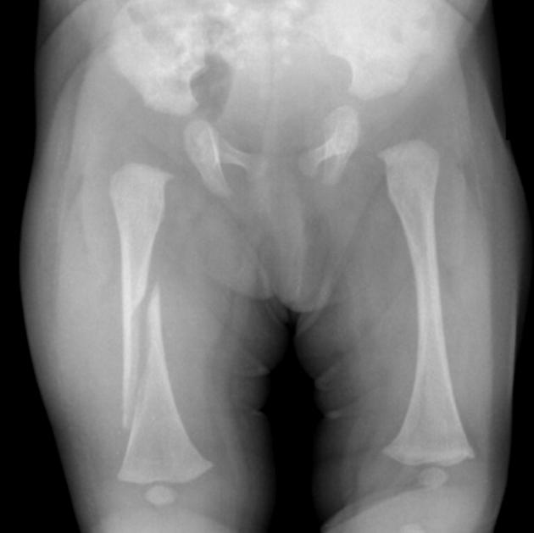

Slide 14
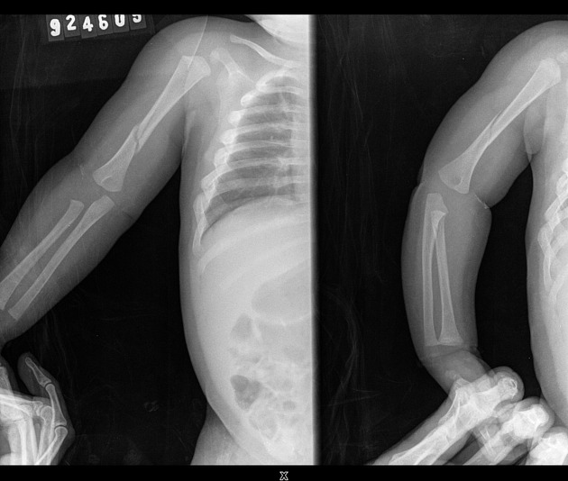

Slide 15
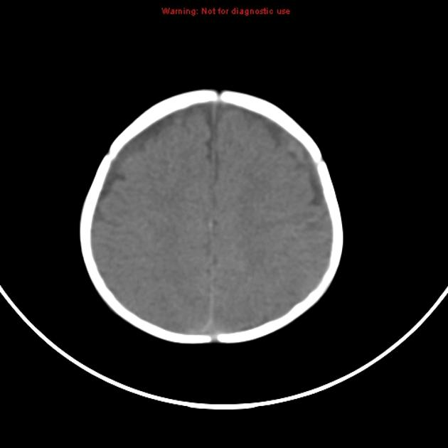

Slide 16
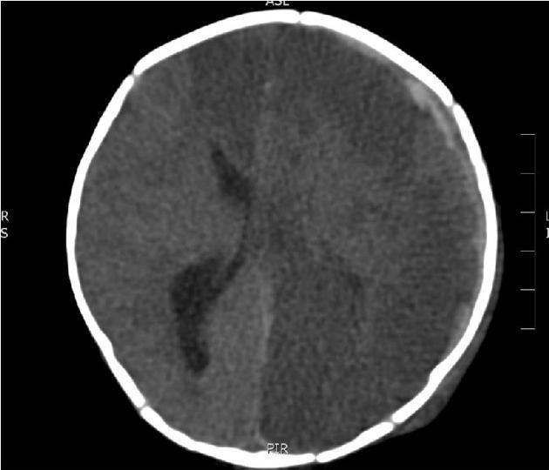

Slide 17
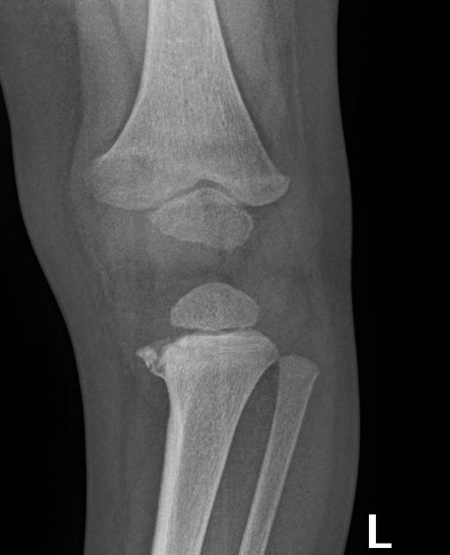

Slide 18
Injuries [non-ortho]
Bruises
Pattern, circumferential, location, mum
Burns
Demarcated, branding
ICH
Abdo
Eyes/retina

Slide 19
Injuries [ortho]
*Metaphyseal # (bucket handle #) – ‘pathognomonic’
*Posterior rib #
*Scapula #
*Spinous process #
Skull #
  Non parietal, multiple, depressed
Sternal #
Multiple, different ages

Slide 20
DD
Accidental
Skeletal dysplasias
Uncommon
Schmid-type metaphyseal chondrodysplasia, osteogenesis imperfecta I/IV
Features to differentiate osteogenesis imperfecta from NAI include
    presence of osteopenia
    bowing/remodelling of bones
    presence of wormian bones
Growth e.g. hip, base 5MT, elbow, acromion
Birth injuries
Rickets
Congenital syphillis

Slide 21
Investigations
Bloods
Directed plain film
Directed CT
Skeletal survey
Skeletal survey
Babygrams?
Bone scan
Clinical photography
Retinal imaging

Slide 22
Resources
Mandatory reporter guide
SCAN (suspected child abuse and neglect) documentation
Child protection helpline 133 627
NSW health child wellbeing unit 1300 480 420
Tertiary children’s hospital – e.g. HI
Family referral services
Child protection training

Slide 23
What do you tell the family?

Slide 24
References
RCH: Child abuse
NSW health guidelines
Radiopedia
The Bone School: Child abuse, NAI
Diagnostic imaging pathways WA

