Slide 1
Spider bites
M Anto
ED prov fellow MVH
12 Jan 2017

Slide 2
Intro
Occurs in warmer times of the yr
NSW: redback, funnel web
Others do not cause serious systemic envenomation, and do not have AV

Slide 3
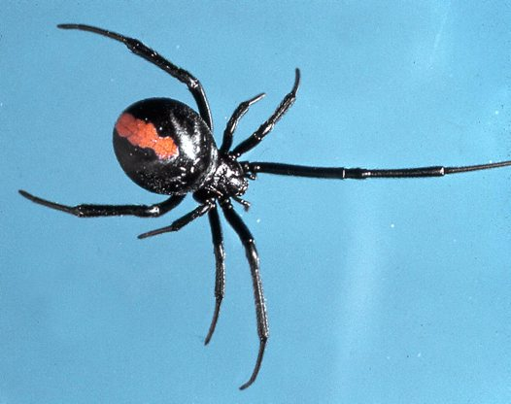

Slide 4
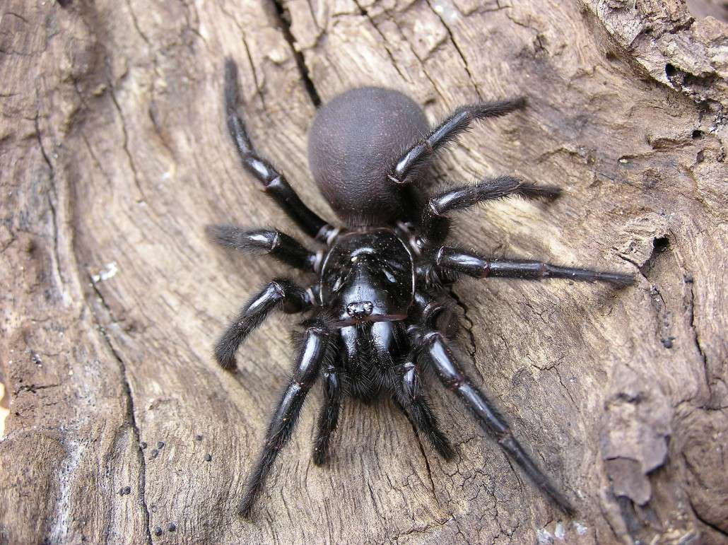

Slide 5
History
Bite
Spider
Geographic location
1st aid
Symptoms:

Slide 6
History
Symptoms:
Perioral paresthesia
Tongue fasciculations
Lacrimation
Salivation
Piloerection
HT
Nausea
Dyspnoea
Decr GCS

Slide 7
Tests
None

Slide 8
Management
Big black spider bites:
Funnel web, may also be mouse or trapdoor
Manage as suspected funnel web for 1st 4hrs
Red back spider bites:
- Severe pain, gradually increasing
Other spiders:
Symptomatic

Slide 9
Red back spider
Pain increasing in severity
Hrs to days
Localised diaphoresis
Non specific symptoms
No deaths since 1950s
Controversy re AV

Slide 10
Funnel web spider
Painful
Fang marks
1st aid: same as snake bite
Observe 4hrs if asymptomatic
Symptoms:
Autonomic – sympathomimetic + cholinergic
Neuromuscular excitation
Cardiogenic – NCPO, hypotension
Coma, MOF
Nonspec – headache, abdopain, anxiety, N+V
Give AV with any systemic sx

Slide 11
Resources
Snakebite and Spiderbite Clinical Management Guidelines (3rd ed, 2014)

