Slide 1
NIV IN ED
M Anto
ED prov fellow MVH
2 Feb 2017

Slide 2
What we will cover today
Brief history
Pt selection
  Indications
  Contraindications
Initiation
Predictors of failure
Benefits
Complications
Summary

Slide 3
What we won’t cover today
HFNP vent for paeds

Slide 4
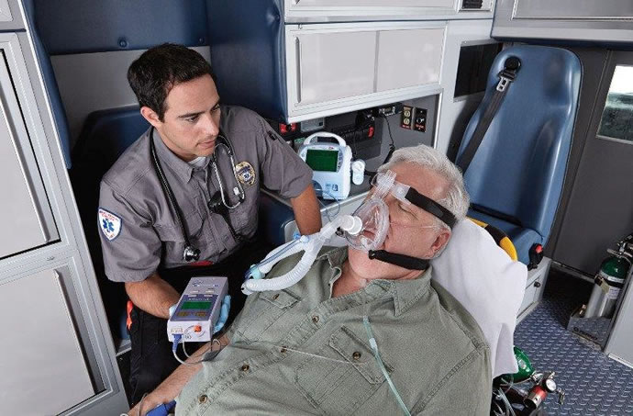

Slide 5
NIV
Mechanical respiratory support without the need for endotracheal intubation through an interface
Continuous positive pressure ventilation
Bilevel positive airway support
Acute and chronic resp failure

Slide 6
Brief history
Reports available from mid 1700s of a bellows-type device
Negative pressure tank device (Dalziel 1832)
Iron lung (Drinker 1928, Emerson 1932)
Positive pressure devices 1952 as neg pressure devices were:
  Large
  Difficult to access pt for cares
  No PEEP
  Leakage
  ‘’Tank shock’’ blood pooled in extremities

Slide 7
Acute respiratory failure
Acute hypoxia requiring supplemental FiO₂ to maintain a SpO₂ ≥92 percent AND/OR
Acute hypercarbia with a PaCO₂ >50 mmHg (with an arterial pH usually <7.35)
In practice, clinicians often intervene based upon oxygen saturation and degree of respiratory distress (eg, severe tachypnoea, retractions), without obtaining blood gases initially

Slide 8
Why do we do it?
Decrease work of breathing
Maintain patency throughout the respiratory tract
  upper airways to the smaller lower airways
  facilitate expiratory flow and reduce obstructive apnea
Recruit alveoli
  increase functional residual capacity (FRC)
  decreased ventilation-perfusion (V-Q) mismatch
Reduces preload
Avoids intubation
Decr ICU LOS/complications
Decr cost

Slide 9
What conditions can NIV be used in?
COPD with hypercapnoeic acidosis
  pCO2 >45
  pH<7.30
Cardiogenic pulmonary oedema
Acute hypoxaemic respiratory failure
  ?Pneumonia
  ?asthma
Post-extubation resp support
Chest trauma despite regional wall anaesthesia
OSA
Delayed sequence intubation
‘’Do not intubate’’ status

Slide 10
COPD (eMedicine)
COPD is the most suitable condition for NIV
Most effective in patients with mod-sev disease
Hypercapnoeic respiratory acidosis may define the best responders (pH 7.20-7.30)
Also effective in patients with a pH of 7.35-7.30, but no added benefit is appreciated if the pH is greater than 7.35
The lowest threshold of effectiveness is unknown, but success has been achieved with pH values as low as 7.10
Obtunded COPD patients can be treated, but the success rate is lower
Improvement after 1-2hr trial may predict success

Slide 11
APO (eMedicine)
NIV is suited for patients with cardiogenic pulmonary edema
CPAP and BiPAP modalities both are effective, with CPAP possibly being more effective
Greatest benefits are relief of symptoms and dyspnoea
Decr in intubation and mortality rates is not a universal experience
Patients with hypercapnoeic respiratory acidosis may derive the greatest benefit from NIV
Adjust to standard therapy, including diuresis
Benefit may be seen within 2hrs of support

Slide 12
Absolute contraindications
Coma
Cardiac arrest
Respiratory arrest
Any condition requiring immediate intubation

Slide 13
Other contraindications
Cardiac instability
GI bleeding
Inability to protect airway
Status epilepticus
Severe decr GCS (except maybe hypercapnoeic encephalopathy)
Facial injuries/burns
Upper airway obstruction e.g. neckmass, anaphylaxis
Lack of trained staff

Slide 14
Pt selection
Cooperative
Dyspnoea (mod-sev)
Tachypnoea RR >25
Incr WOB
Hypercapnoeic resp acidosis
Hypoxaemic

Slide 15
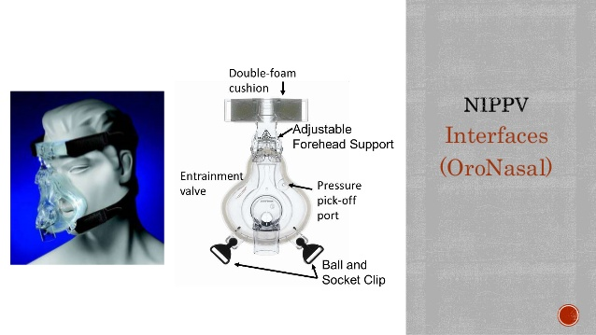

Slide 16
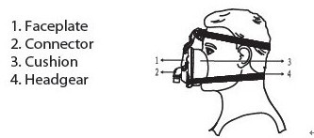

Slide 17
Modes of ventilation
BiPAP pressure (preferred)
  Assist mode or pressure support ventilation
  With or without apnoea back-up
  Pressure control ventilation (less used in ED)
BiPAP volume (not used much in ED)
CPAP
  Not a ventilatory mode

Slide 18
Goals of initial therapy
Start with IPAP 10 + EPAP 5
(equivalent to PS 5 + PEEP 5)
(IPAP = PS + PEEP)
(EPAP = PEEP)
TV = 6ml/kg IBW
RR <25
[Back-up rate 12-16]
SpO2 >90%
Aim for improvement in 2hrs

Slide 19
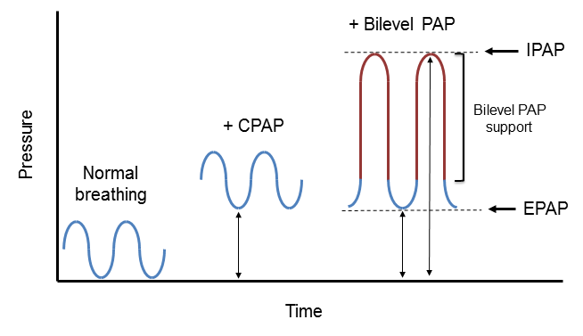

Slide 20
Titration
If SpO2 <90%
  then incr EPAP/PEEP (max 15cmH2O)
If RR >25, or incr/persistant acidosis/hypercapnoea
  then incr IPAP (max 25cm)
  to incr VT by 1ml/kg IBW q15min (max 8ml/kg)

Slide 21
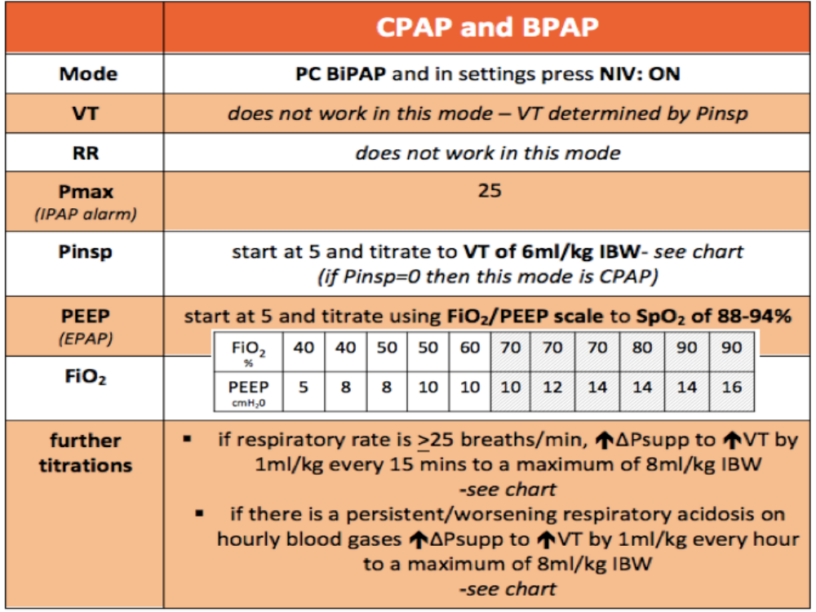

Slide 22
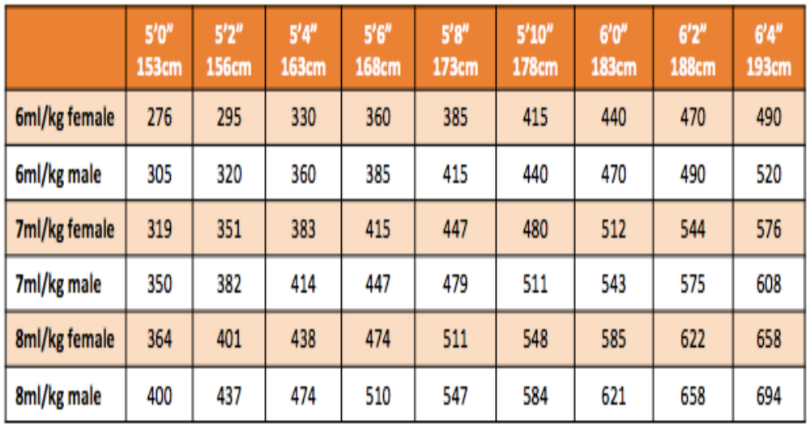

Slide 23
Monitoring/weaning
ABG
RR, SpO2, WOB, HR
Give breaks every 30-90min
Decr IPAP/EPAP once stable/improving

Slide 24
Success
Decr pCO2
Improve pO2
Improve pH
Decr RR
Decr WOB
Decr HR

Slide 25
Failure
No improvement
Deterioration
Decr GCS
Hypotension
MI or arrhythmias
Pt intolerance of treatment

Slide 26
Complications
Gastric distension, vomiting, aspiration
Drying of secretions, mucous plugging, nasal congestion, eye irritation
Hypotension
PTx
Anxiety/claustrophobia
Facial/nasal skin breakdown

Slide 27
Summary
Good for COPD + APO
Consider for other indications + no CI
Start at standard settings, and titrate
Monitor and wean/escalate as required
Consider sedation

Slide 28
References
Uptodate
eMedicine
Guide for NIV using the draeger oxylog 3000plus (LITFL, G Douros)

