Slide 1
Introduction to palliative care at
Northern Beaches Hospital
Dr Abbie Franklin
Brigitte Karle
Joanne Rainback
CNC Palliative Care

Slide 2
The palliative care team at Northern Beaches
Dr Abbie Franklin Staff specialist (works 2 ½ days)
(Dr Peter Roach Staff Specialist) relieves annual leave
Brigitte Karle CNC
Joanne Rainback CNC
Consultative service 5 days a week
Employed by HammondCare, who contracts with Healthscope to provide this service.

Slide 3
How to refer to Palliative Care
0408 786 7099 5 days a week.
EMR palliative medicine referral.
Over the weekends there is NO ON CALL SERVICE.

Slide 4
Take home points
Palliative care is not only for cancer patients.
We need to identify dying
We need to relieve suffering
Regular pain/symptom relief is better than PRN.
We need to improve our communication skills.

Slide 5
WHO Definition of Palliative Care
Palliative care is an approach that improves the quality of life of patients and their families facing the problem associated with life-threatening illness,
through the prevention and relief of suffering by means of early identification and impeccable assessment and treatment of pain and other problems, physical, psychosocial and spiritual.

Slide 6
WHO Definition of Palliative Care
provides relief from pain and other distressing symptoms;
affirms life and regards dying as a normal process;
intends neither to hasten or postpone death;
integrates the psychological and spiritual aspects of patient care;
offers a support system to help patients live as actively as possible until death;
www.who.int/cancer/palliative/definition/en/

Slide 7
WHO Definition of Palliative Care
offers a support system to help the family cope during the patient’s illness and in their own bereavement;
uses a team approach to address the needs of patients and their families, including bereavement counselling, if indicated;
will enhance quality of life, and may also positively influence the course of illness;

Slide 8
WHO Definition of Palliative Care
is applicable early in the course of illness, in conjunction with other therapies that are intended to prolong life, such as chemotherapy or radiation therapy,
and includes those investigations needed to better understand and manage distressing clinical complications.
/

Slide 9
Other benefits of early introduction of palliative care
Improved health related quality of life
Improved symptom management
People stay at home longer .
More discussions from patients to their families and doctors about what their wishes are.
More people die in their place of choice.
It may even prolong life (Temel et al sentinel work, 2010)

Slide 10
Link between NBH and community
1. May be known to the community team.(NSLHD)
Northern Beaches: situated in Mona Vale:
Greenwich: for North Shore patients.
Neringah (Wahroonga) for patients from St Ives to Castle Hill.
a team of doctors, nurses, OTs , social workers, etc.
A consultative service.
2. May have an ambulance plan, stating “Do not return to hospital”.
Why do they come here?
Family override ambos (symptoms not well controlled.)
Scared of them dying at home.
No bed at the PCU.
Middle of the night admissions unusual to PCU (better to transfer straight from home).
Can be transferred DIRECTLY from ED to PCU if known to the community palliative care team.

Slide 11
Why do we need palliative care in an acute hospital?
Because it is important to recognise when a person is approaching end of life.
It matters how people die.
It matters to them and to their families.
Futile treatment / “freeway” to ICU is not always the best place for older , frail people with advanced disease.

Slide 12
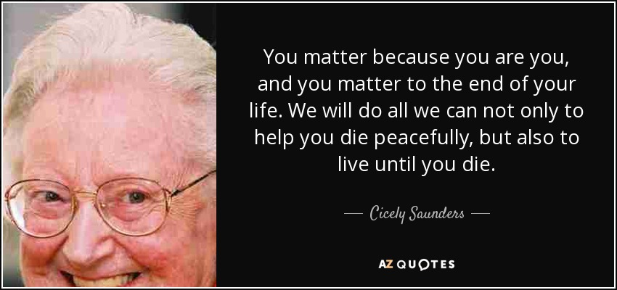

Slide 13
Recognising dying
Identifying which patients are approaching the end-of-life phase is crucial to delivering appropriate health care.
Recognition of end of life allows patients and families to plan for inevitable death.
Many people state that they prefer honest and upfront conversations about prognosis so that preparation for the end of life can begin.
However only around 14% of Australians have completed an advance care directive.
This means that for many patients and families’ conversations about end-of-life choices will happen for the first time during a health crisis or when you ask.

Slide 14
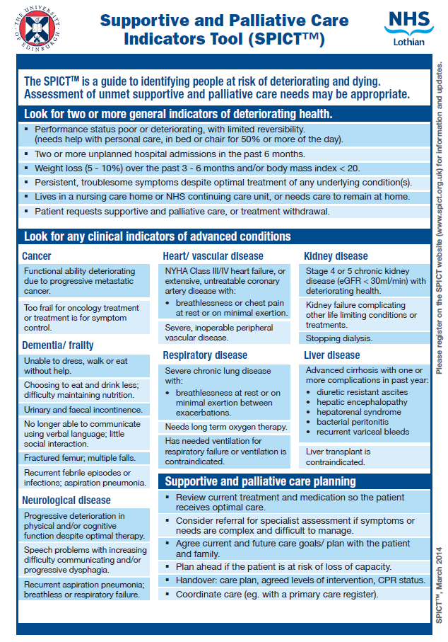
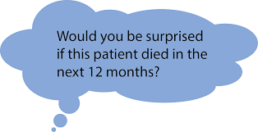
http://www.spict.org.uk/about/

Slide 15
Therapies with the potential for overuse
Chemotherapy.
Radiotherapy.
Life sustaining therapies.
Imaging.
Blood testing.
Non-beneficial medication.

Slide 16
Potentially underused interventions
Early conversations about patients care goals and values.
Family support.
Carefully titrated pain control with follow up.
Nonpain symptom management.
Psychosocial and spiritual support.

Slide 17
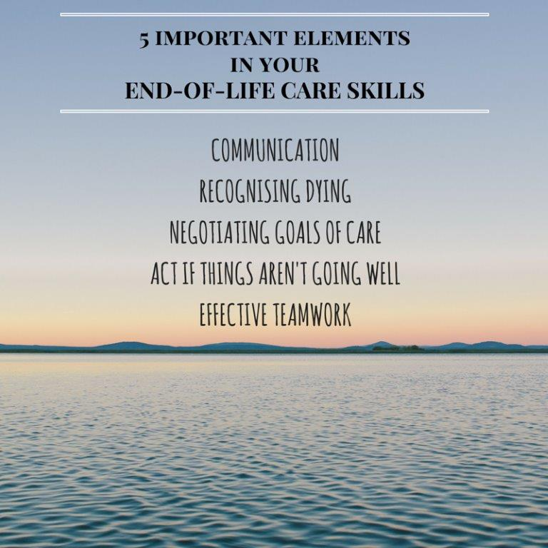

Slide 18
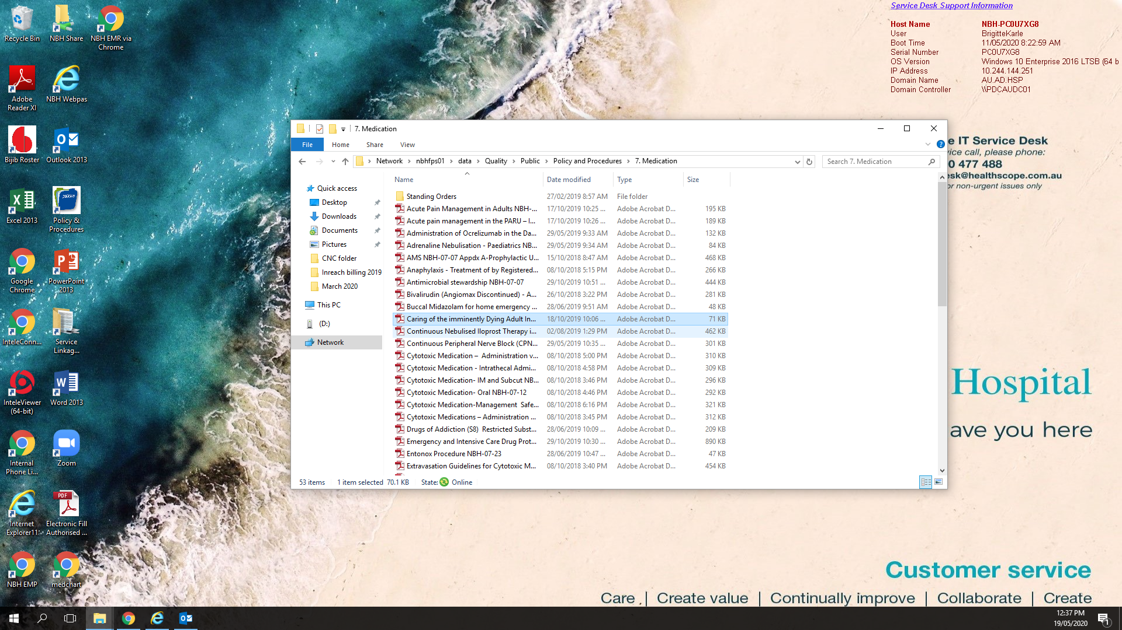

Slide 19
Introducing the AMBER care bundle: how it works
Assessment
Management
Best Practice
Engagement of patients/carers for patients Recovery is uncertain
© 2013 Guy’s & St. Thomas’ NHS Foundation Trust

Slide 20
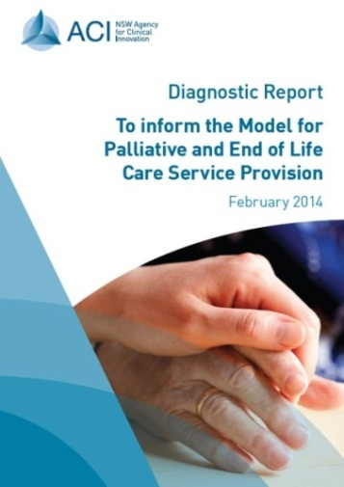
How we die in NSW – the case for change
Report* examined cost & utilisation of 37,000 people who died in 2011/12 and were hospitalised in their last year of life
Average 4 admissions with average LOS of 10 days (average LOS = 4 days)
Approx. 984,000 bed days at cost of just over $900 million
High proportion of emergency / unplanned admissions
NSW BTF data shows up to 30% of Rapid Response calls are for patients who are dying as a natural and unpreventable progression of their illness
Lack of a standardised approach in the last days of life
*ACI – Diagnostic report, 2014

Slide 21
The case for change at NBH:
Admitted Patient Death Screening Tool. (CEC) Audit conducted
Random sample of 20 NBH Inpatient Adult Deaths from November 2019
15 % of Patients had YELLOW Zone observations or additional criteria in the 24 hours prior to death and a Clinical Review or other CERS call documented
45% of Patient had RED Zone observations or additional criteria in the 24 hours prior to death and a Rapid Response call documented
75 % of patients had symptoms of patient discomfort or distress documented in the medical record in the 48 hours before death and symptoms managed by the treating team
60% of patients had a formal medication management plan/guide used to manage the patient’s pain/symptoms in the last 24‐72 hours
0% of patients had a standardised framework/guideline/plan used to guidecare in the last days of life
.
do you have one for organisation/facility? If yes how well is it used? If not how do you know how you manage dying/approaching death?

Slide 22
The case for change: cont.
50% of patients had Readmission within 28 days from previous hospitalization
If YES,
A new problem 10%
Same problem 90%
30% of patients had unplanned ICU admission
20% of patients had an Operative procedure in the 30 days prior to death
5% Unplanned return to Theatre
20% of patients Unexpected Death not reasonably preventable with clinical intervention
80% of patients Anticipated death due to disease progression and could of been eligible for Amber Care bundle
do you have one for organisation/facility? If yes how well is it used? If not how do you know how you manage dying/approaching death?

Slide 23
What is a Care bundle?
Bundle has:
Four to five components
Can be rapidly answered yes/no
Based on good evidence or self evident good practice
Can be locally implemented / quality controlled
Helps communication and team working
Easy to measure
Using Care Bundles to Improve Health Care Quality Resar R et al (2012)
(Available on www.IHI.org) BMJ. 2010 Mar 31;340:c1234. doi: 10.1136/bmj.c1234

Slide 24
AMBER care bundle
Developed at Guy’s and St Thomas’ Trust in the UK
Designed to prompt medical teams to have conversations with patients and their carers when recovery uncertain
Four components to the approach:
  Talk to patient and family re concerns about their condition, and discuss preferences and wishes
  Confirm the current management plan
  Identify how the patient will be cared for should their condition get worse
  Agree plan with MDT as well as the patient and family.
May still be being actively treated - not waiting until the patient is dying

Slide 25
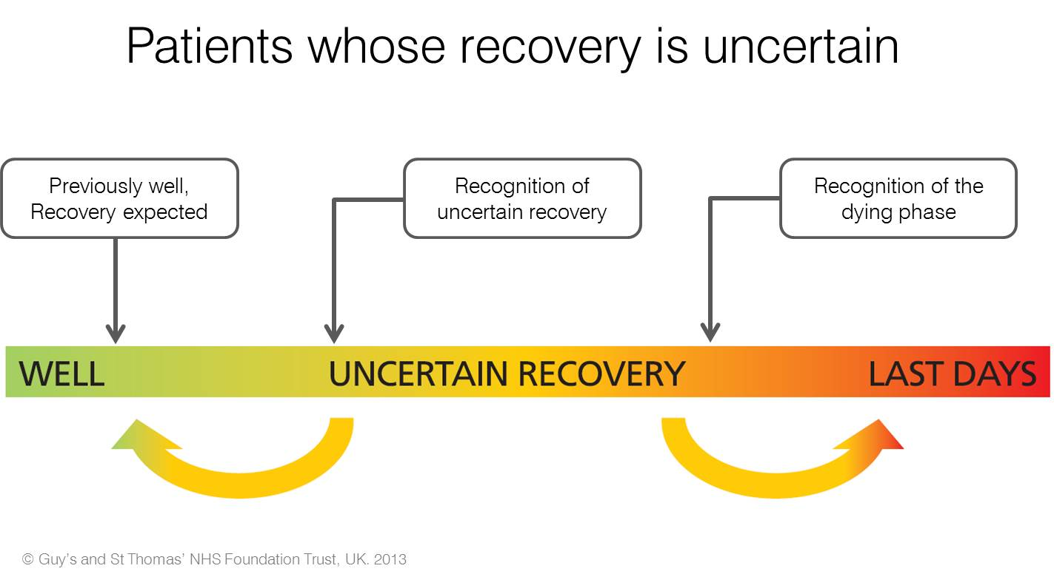
Where it fits

Slide 26
Stage 1 – Identifying the patient
N.B Any member of the team can identify a patient who is suitable for the AMBER care bundle
Is the patient deteriorating, clinically unstable and with limited reversibility? and
Is the patient at risk of dying during this episode of care despite treatment?
Yes √ to both → AMBER care bundle

Slide 27
Identifying the patient
Clinical Assessment - Is the patient’s condition serious enough that even with active treatment there is uncertainty that they will recover?
Review the patient’s admission notes
  History (co morbidities);
  recent admissions;
  physical examination;
  medications
Trigger tools available to give guidance

Slide 28
Supportive & Palliative Care Indicators Tool
Readily identifiable indicators of deteriorating health commonly present in advanced conditions
Promotes early supportive palliative care in parallel with optimal management of any underlying conditions as part of routine clinical practice
Evidence-based clinical indicators of all the major advanced, life-limiting conditions and multi-morbidity
Contains accessible language and concepts that can be used to initiate discussions with patients and families about goals of care and improve communication between professionals/ teams
Simple, one page format
http://www.spict.org.uk/about/

Slide 29
Stage 2 - Day 1 Interventions
Within 12 hours of patient identification
patient/carer discussion documented in medical record
patient's preferred place of care documented
medical plan documented in progress notes
escalation decision documented for clinical reviews and rapid response team
resuscitation plan completed
“Randomised trials have shown that timely and nuanced discussions around end of life care options can improve quality of life, prolong survival, reduce use of aggressive care and lower healthcare costs.”
Editorial, Australian Internal Medicine Journal, October 2014

Slide 30
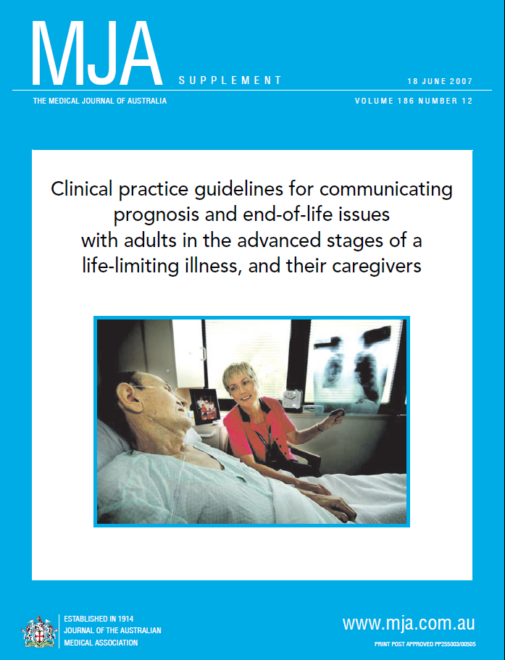
Meeting the Patient & Family
Meet the patient and family:
  Discuss medical condition and proposed management plan
  Acknowledge patients ‘uncertain’ recovery and what will be done by the team and what (if any) time limited trial of therapy will be implemented
  Identify what the patient / family see as a good outcome
  Agree on management plan, escalation plan and follow up plan
  Assess concerns, including potential family interpersonal problems
Notes:
30
Meeting the Patient
Review the patient’s admission notes
History and physical
Medication reconciliation
Preliminary plan of care
Meet the patient and family
Describe DA’s role
Assess concerns, including potential post-discharge needs
Initiate Patient Care Plan and checklist

Slide 31
Documentation
There should be detailed documentation of the conversation with the patient and family/carer around management plan. At a minimum should include:
  who was present in discussion (both the MDT and family members)
  what information was given
  what were patient's concerns/choices
  did the patient and/or family / carer understand the patient’s condition and the goals of care
  did the patient have a preference for place of death
Indicators of symptom/pain control, psychosocial and spiritual support (including family care) were addressed

Slide 32
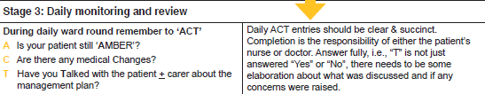
Stage 3 - Daily monitor/review ‘ACT’
  A Is patient still AMBER?
  C Has medical plan Changed?
  T Have you Talked with the patient and family/carers
  Is everything OK?”

Slide 33
Daily monitoring / review using ‘ACT’
Can be done by either nursing or medical staff or as part to the multidisciplinary round
Clarify any concerns with all members of health care team
Visit the patient
  Review treatment plan
  Discuss patient/family concerns
  Discuss preferred place of death (if appropriate)
Not an ‘add on’ task – done as part of routine daily patient review
Document findings, discussions with patient / family and any changes to care plan
Notes:
Discharge Planning Rounds
Image: Photo of a team conducting rounds in a hospital.

Slide 34
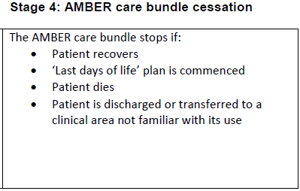
Stage 4 - Cessation Details
Reason for AMBER cessation documented
AMBER cessation discussed with GP/LMO
Document patient wishes/outcomes of discussion on discharge summary
Last days of life plan commenced (if applicable)

Slide 35
Be prepared:
Look on PowerChart: there may already have been goals of care discussed in the community.
Have discussions with oncologists first.
Know your patient’s clinical condition.
2. Never ask people if they want CPR.
This is an unfair question.
It makes people think they can decide when they live or die.
Know that in certain conditions CPR doesn’t work, in non-cardiac, frail, elderly.
“Given the severity of your illness, CPR has almost no chance of being effective, and I do not recommend that you have it. We will continue to give you all treatments that are effective to keep you comfortable.”

Slide 36
Abbie’s Top 4 Conversation tips
3. If the conversation is getting heated, or people are becoming distressed have a “Time out” comment.
Blame the disease.
“Oh, my goodness, X is a terrible disease”
4. If the conversation is falling to pieces, it’s OK to bail.
Don’t see it as a failure, it will make the next person’s life easier when they initiate the conversation.

Slide 38
Sentences we hate…..
We are going to fully palliate now…..
There’s nothing left to do for you, we’re going to refer you to the palliative care team now.

Slide 39


Slide 40
References
Caresearch Training (2019) https://training.caresearch.com.au/learner/course

